Slide 1

Network+ Guide to Networks 6th Edition
Chapter 9
In-Depth TCP/IP Networking

Slide 2
Objectives
Describe methods of network design unique to TCP/IP networks, including subnetting, CIDR, and address translation
Explain the differences between public and private TCP/IP networks
Describe protocols used between mail clients and mail servers, including SMTP, POP3, and IMAP4
Employ multiple TCP/IP utilities for network discovery and troubleshooting

Slide 3
Designing TCP/IP-Based Networks
TCP/IP protocol suite use
Internet connectivity
Private connection data transmission
TCP/IP fundamentals
IP: routable protocol
Interfaces requires unique IP address
Node may use multiple IP addresses
Two IP versions: IPv4 and IPv6
Networks may assign IP addresses dynamically

Slide 4
Subnetting
Separates network
Multiple logically defined segments (subnets)
Geographic locations, departmental boundaries, technology types
Subnet traffic separated from other subnet traffic
Reasons to separate traffic
Enhance security
Improve performance
Simplify troubleshooting

Slide 5
Subnetting (cont’d.)
Classful addressing in IPv4
First, simplest IPv4 addressing type
Adheres to network class distinctions
Recognizes Class A, B, C addresses
Drawbacks
Fixed network ID size limits number of network hosts
Difficult to separate traffic from various parts of a network

Slide 6
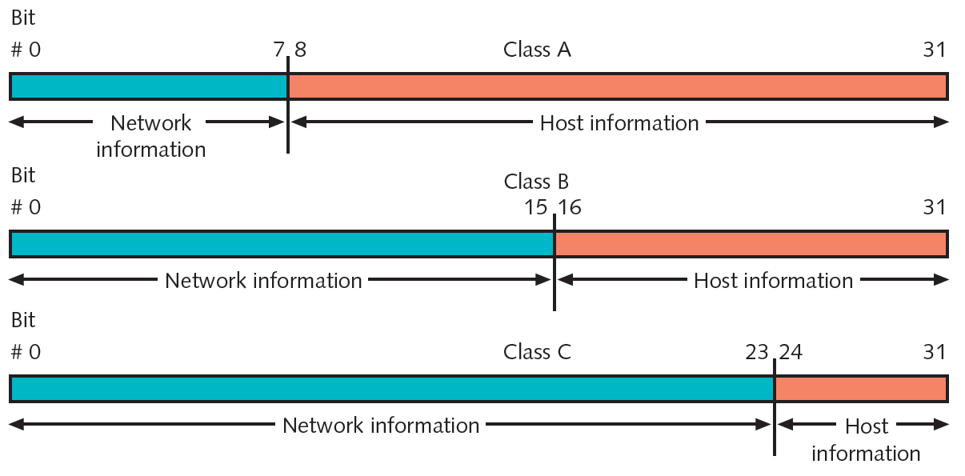
Subnetting (cont’d.)
Figure 9-1 Network and host information in classful IPv4 addressing
Courtesy Course Technology/Cengage Learning

Slide 7
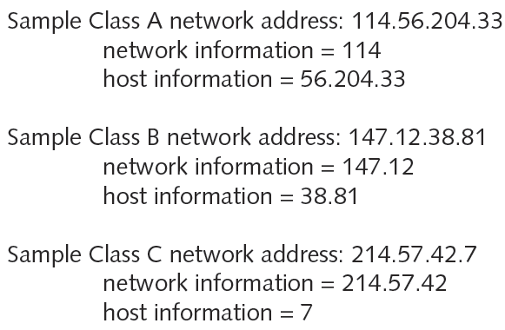
Subnetting (cont’d.)
Figure 9-2 Sample IPv4 addresses with classful addressing
Courtesy Course Technology/Cengage Learning

Slide 8
Subnetting (cont’d.)
IPv4 subnet masks
Identifies how network subdivided
Indicates where network information located
Subnet mask bits
1: corresponding IPv4 address bits contain network information
0: corresponding IPv4 address bits contain host information
Network class
Associated with default subnet mask

Slide 9
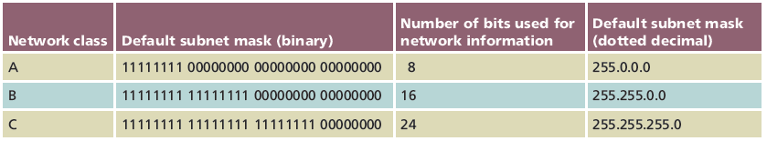
Subnetting (cont’d.)
Table 9-1 Default IPv4 subnet masks
Courtesy Course Technology/Cengage Learning

Slide 10
Subnetting (cont’d.)
ANDing
Combining bits
Bit value of 1 plus another bit value of 1 results in 1
Bit value of 0 plus any other bit results in 0
Logic
1: “true”
0: “false”

Slide 11
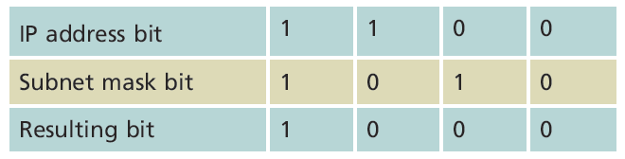
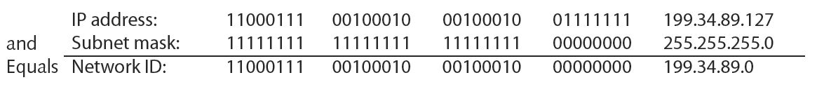
Table 9-2 ANDing
Courtesy Course Technology/Cengage Learning
Figure 9-3 Example of calculating a host’s network ID
Courtesy Course Technology/Cengage Learning

Slide 12
Subnetting (cont’d.)
Special addresses
Cannot be assigned to node network interface
Used as subnet masks
Examples of special addresses
Network ID
Broadcast address

Slide 13
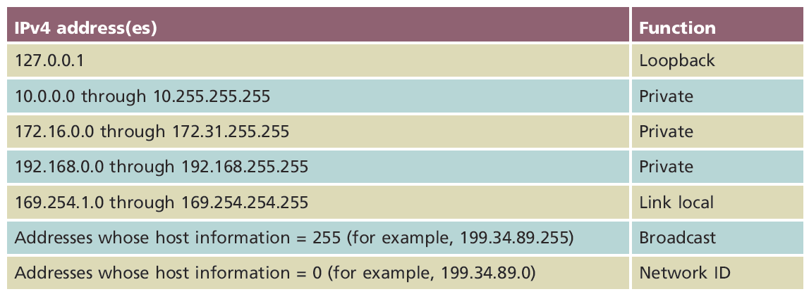
Table 9-3 IPv4 addresses reserved for special functions
Courtesy Course Technology/Cengage Learning

Slide 14
Subnetting (cont’d.)
IPv4 subnetting techniques
Subnetting alters classful IPv4 addressing rules
IP address bits representing host information change to represent network information
Reduces usable host addresses per subnet
Number of hosts, subnets available after subnetting depend on host information bits borrowed

Slide 15
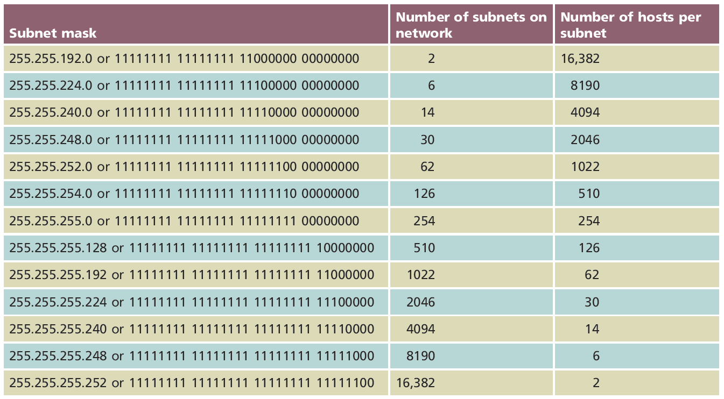
Table 9-4 Class B subnet masks
Courtesy Course Technology/Cengage Learning

Slide 16
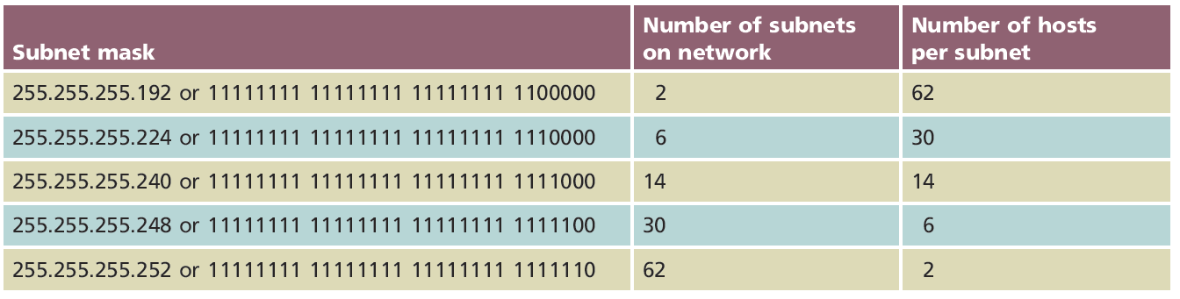
Table 9-5 IPv4 Class C subnet masks
Courtesy Course Technology/Cengage Learning

Slide 17
Subnetting (cont’d.)
Calculating IPv4 Subnets
Formula: 2^{n} −2=Y
n: number of subnet mask bits needed to switch from 0 to 1
Y: number of resulting subnets
Example
Class C network
Network ID: 199.34.89.0
Want to divide into six subnets

Slide 18
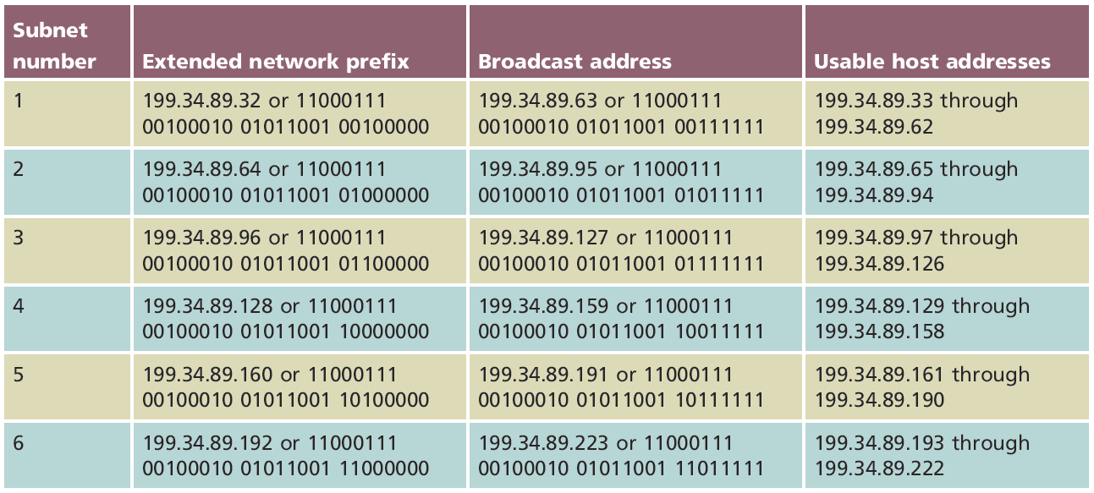
Table 9-6 Subnet information for six subnets in a sample IPv4 Class C network
Courtesy Course Technology/Cengage Learning

Slide 19
Subnetting (cont’d.)
Class A, Class B, and Class C networks
Can be subnetted
Each class has different number of host information bits usable for subnet information
Varies depending on network class and the way subnetting is used
LAN subnetting
LAN’s devices interpret device subnetting information
External routers
Need network portion of device IP address

Slide 20
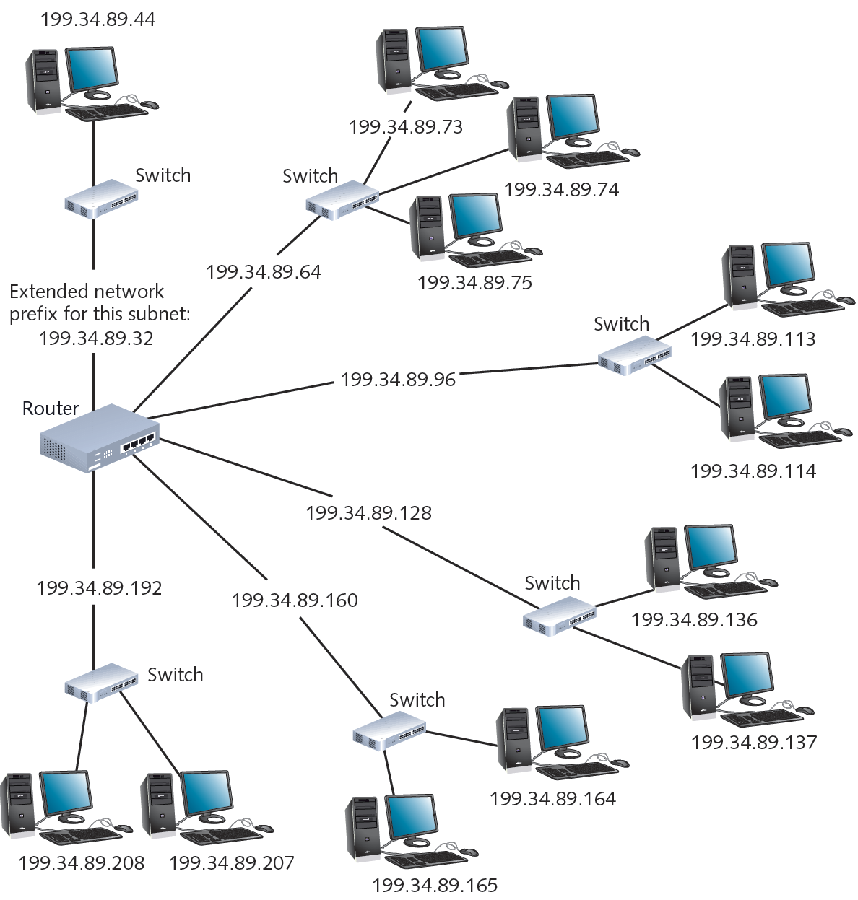
Figure 9-4 A router connecting several subnets
Courtesy Course Technology/Cengage Learning

Slide 21
CIDR (Classless Interdomain Routing)
Also called classless routing or supernetting
Not exclusive of subnetting
Provides additional ways of arranging network and host information in an IP address
Conventional network class distinctions do not exist
Example: subdividing Class C network into six subnets of 30 addressable hosts each
Supernet
Subnet created by moving subnet boundary left

Slide 22
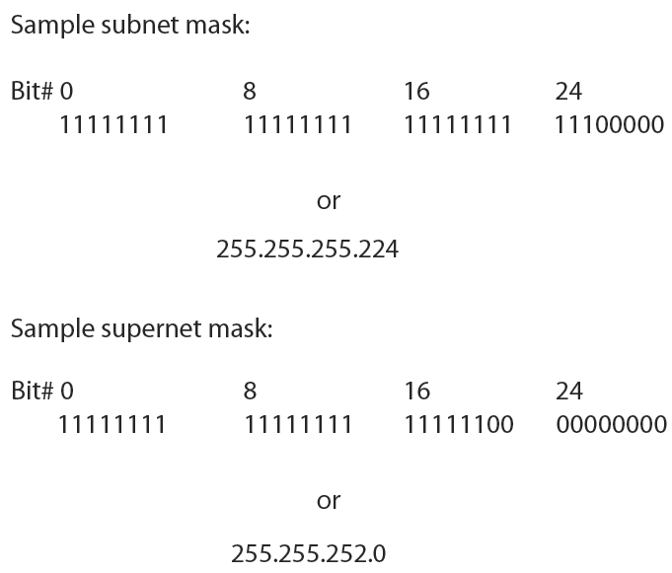
Figure 9-5 Subnet mask and supernet mask
Courtesy Course Technology/Cengage Learning

Slide 23
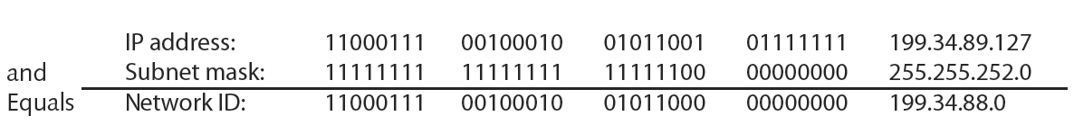
CIDR (cont’d.)
Example: class C range of IPv4 addresses sharing network ID 199.34.89.0
Need to greatly increase number of default host addresses
Figure 9-6 Calculating a host’s network ID on a supernetted network
Courtesy Course Technology/Cengage Learning

Slide 24
CIDR (cont’d.)
CIDR notation (or slash notation)
Shorthand denoting subnet boundary position
Form
Network ID followed by forward slash ( / )
Followed by number of bits used for extended network prefix
CIDR block
Forward slash, plus number of bits used for extended network prefix
Example: /22

Slide 25
Subnetting in IPv6
Each ISP can offer customers an entire IPv6 subnet
Subnetting in IPv6
Simpler than IPv4
Classes not used
Subnet masks not used
Subnet represented by leftmost 64 bits in an address
Route prefix
Slash notation is used

Slide 26
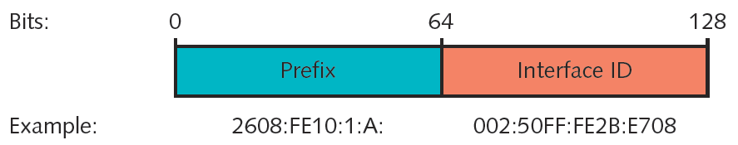
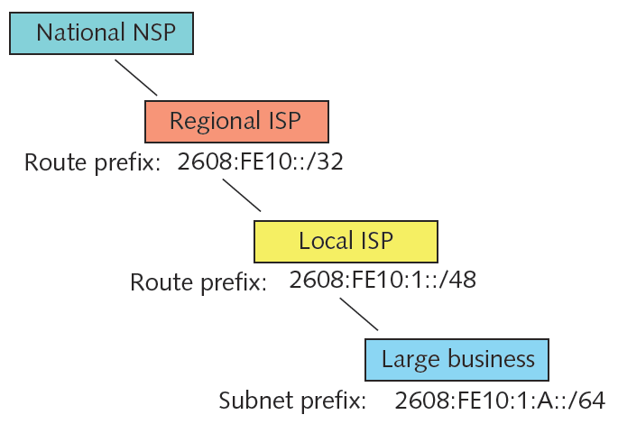
Figure 9-7 Subnet prefix and interface ID in an IPv6 address
Courtesy Course Technology/Cengage Learning
Figure 9-8 Hierarchy of IPv6 routes and subnets
Courtesy Course Technology/Cengage Learning

Slide 27
Internet Gateways
Combination of software and hardware
Enables different network segments to exchange data
Default gateway
Interprets outbound requests to other subnets
Interprets inbound requests from other subnets
Network nodes
Allowed one default gateway
Assigned manually or automatically (DHCP)

Slide 28
Internet Gateways (cont’d.)
Gateway interface on router
Advantages
One router can supply multiple gateways
Gateway assigned own IP address
Default gateway connections
Multiple internal networks
Internal network with external networks
WANs, Internet
Router used as gateway
Must maintain routing tables

Slide 29
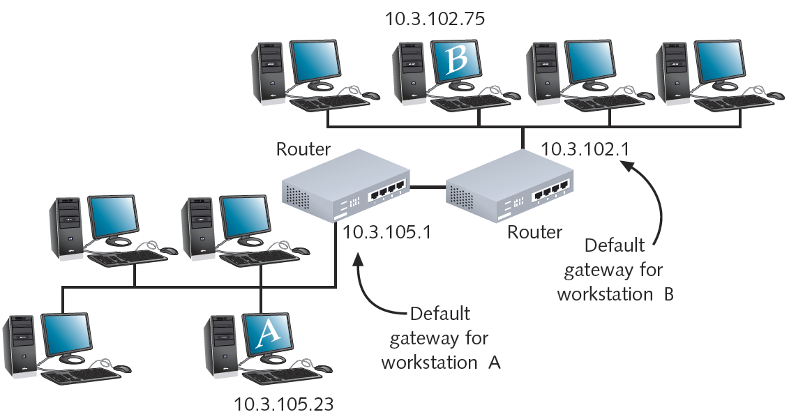
Figure 9-9 The use of default gateways
Courtesy Course Technology/Cengage Learning

Slide 30
Address Translation
Public network
Any user may access
Little or no restrictions
Private network
Access restricted
Clients, machines with proper credentials
Hiding IP addresses
Provides more flexibility in assigning addresses
NAT (Network Address Translation)
Gateway replaces client’s private IP address with Internet-recognized IP address

Slide 31
Address Translation (cont’d.)
Reasons for using address translation
Overcome IPv4 address quantity limitations
Add marginal security to private network when connected to public network
Use own network addressing scheme
SNAT (Static Network Address Translation)
Client associated with one private IP address, one public IP address
Addresses never change
Useful when operating mail server

Slide 32
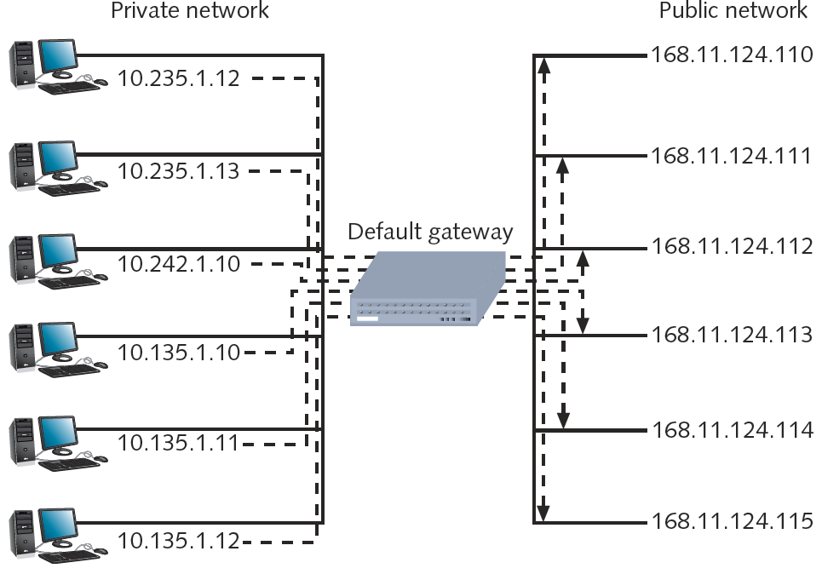
Figure 9-10 SNAT (Static Network Address Translation)
Courtesy Course Technology/Cengage Learning

Slide 33
Address Translation (cont’d.)
DNAT (Dynamic Network Address Translation)
Also called IP masquerading
Internet-valid IP address might be assigned to any client’s outgoing transmission
PAT (Port Address Translation)
Each client session with server on Internet assigned separate TCP port number
Client server request datagram contains port number
Internet server responds with datagram’s destination address including same port number

Slide 34
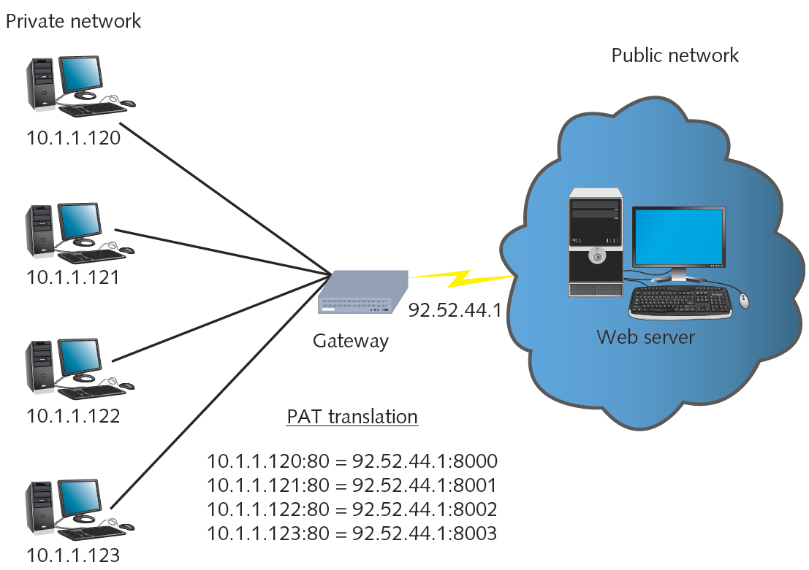
Figure 9-11 PAT (Port Address Translation)
Courtesy Course Technology/Cengage Learning

Slide 35
Address Translation (cont’d.)
NAT
Separates private, public transmissions on TCP/IP network
Gateways conduct network translation
Most networks use router
Gateway might operate on network host
Windows operating systems
ICS (Internet Connection Sharing)

Slide 36
TCP/IP Mail Services
Internet mail services
Mail delivery, storage, pickup
Mail servers
Communicate with other mail servers
Deliver messages, send, receive, store messages
Popular programs: Sendmail, Microsoft Exchange Server
Mail clients
Send and retrieve messages to/from mail servers
Popular programs: Microsoft Outlook, Thunderbird

Slide 37
SMTP (Simple Mail Transfer Protocol)
Protocol responsible for moving messages
From one mail server to another
Over TCP/IP-based networks
Operates at Application layer
Relies on TCP at Transport layer
Operates from port 25
Provides basis for Internet e-mail service
Relies on higher-level programs for its instructions
Services provide friendly, sophisticated mail interfaces

Slide 38
SMTP (cont’d.)
Simple subprotocol
Transports mail, holds it in a queue
Client e-mail configuration
Identify user’s SMTP server
Use DNS: Identify name only
No port definition
Client workstation, server assume port 25

Slide 39
MIME (Multipurpose Internet Mail Extensions)
SMPT drawback: 1000 ASCII character limit
MIME standard
Encodes, interprets binary files, images, video, non-ASCII character sets within e-mail message
Identifies each mail message element according to content type
Text, graphics, audio, video, multipart
Does not replace SMTP
Works in conjunction with it
Encodes different content types
Fools SMTP

Slide 40
POP (Post Office Protocol)
Application layer protocol
Retrieve messages from mail server
POP3 (Post Office Protocol, version 3)
Current, popular version
Relies on TCP; operates over port 110
Store-and-forward type of service
Advantages
Minimizes server resources
Mail deleted from server after retrieval (disadvantage for mobile users)
Mail server, client applications support POP3

Slide 41
IMAP (Internet Message Access Protocol)
More sophisticated alternative to POP3
IMAP4: current version
Advantages
Replace POP3 without having to change e-mail programs
E-mail stays on server after retrieval
Good for mobile users

Slide 42
IMAP (cont’d.)
Features
Users can retrieve all or portion of mail message
Users can review messages and delete them
While messages remain on server
Users can create sophisticated methods of organizing messages on server
Users can share mailbox in central location

Slide 43
IMAP (cont’d.)
Disadvantages
Requires more storage space, processing resources than POP servers
Network managers must watch user allocations closely
IMAP4 server failure
Users cannot access mail

Slide 44
Additional TCP/IP Utilities
TCP/IP transmission process
Many points of failure
Increase with network size, distance
Utilities
Help track down most TCP/IP-related problems
Help discover information about node, network
Nearly all TCP/IP utilities
Accessible from command prompt
Syntax differs per operating system

Slide 45
Ipconfig
Command-line utility providing network adapter information
IP address, subnet mask, default gateway
Windows operating system tool
Command prompt window
Type ipconfig and press Enter
Switches manage TCP/IP settings
Forward slash ( / ) precedes command switches
Requires administrator rights
To change workstation’s IP configuration

Slide 46
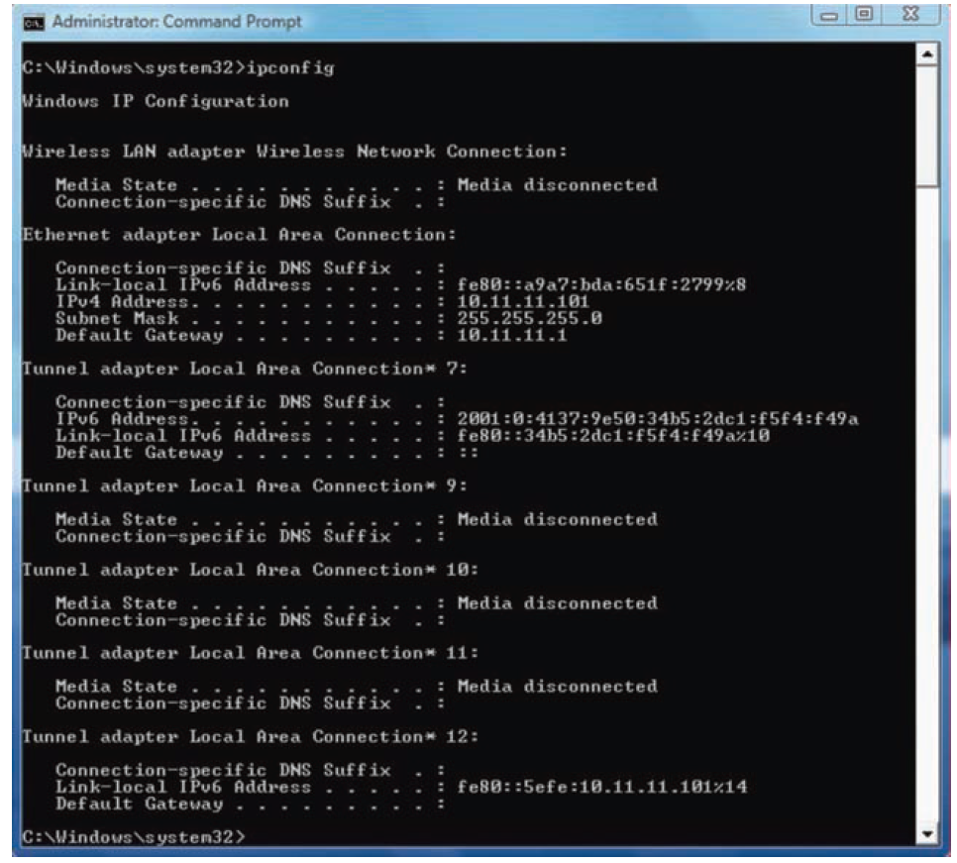
Figure 9-12 Output of an ipconfig command on a Windows workstation
Courtesy Course Technology/Cengage Learning

Slide 47
Ifconfig
Utility used on UNIX and Linux systems
Modify TCP/IP network interface settings
Release, renew DHCP-assigned addresses
Check TCP/IP setting status
Runs at UNIX, Linux system starts
Establishes computer TCP/IP configuration
Used alone or with switches
Uses hyphen ( - ) before some switches
No preceding character for other switches

Slide 48
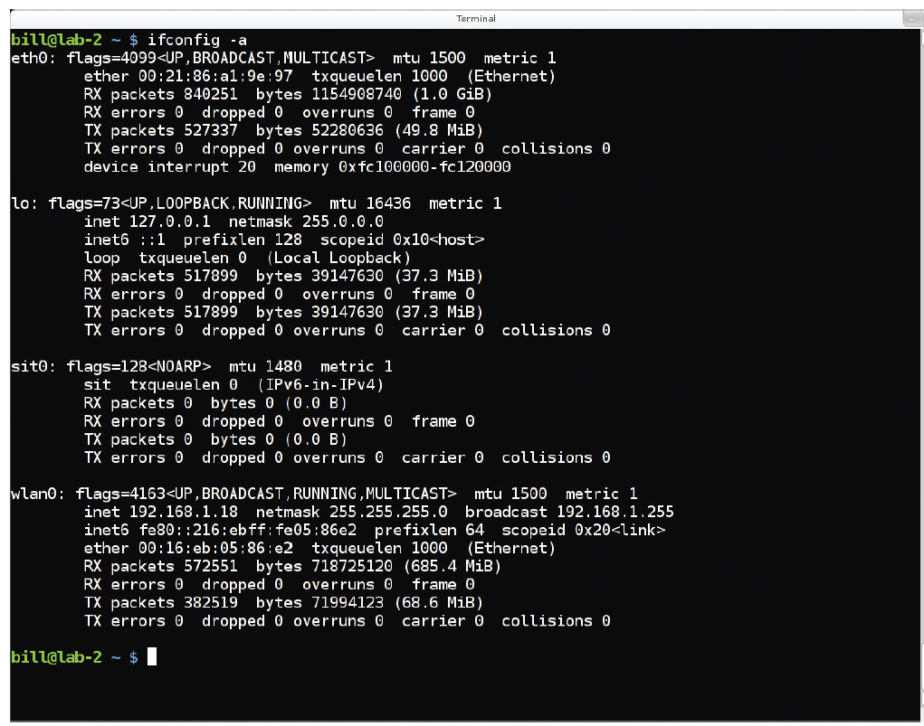
Figure 9-13 Detailed information available through ifconfig
Courtesy Course Technology/Cengage Learning

Slide 49
Netstat
Displays TCP/IP statistics, component details, host connections
Used without switches
Displays active TCP/IP connections on machine
Can be used with switches

Slide 50
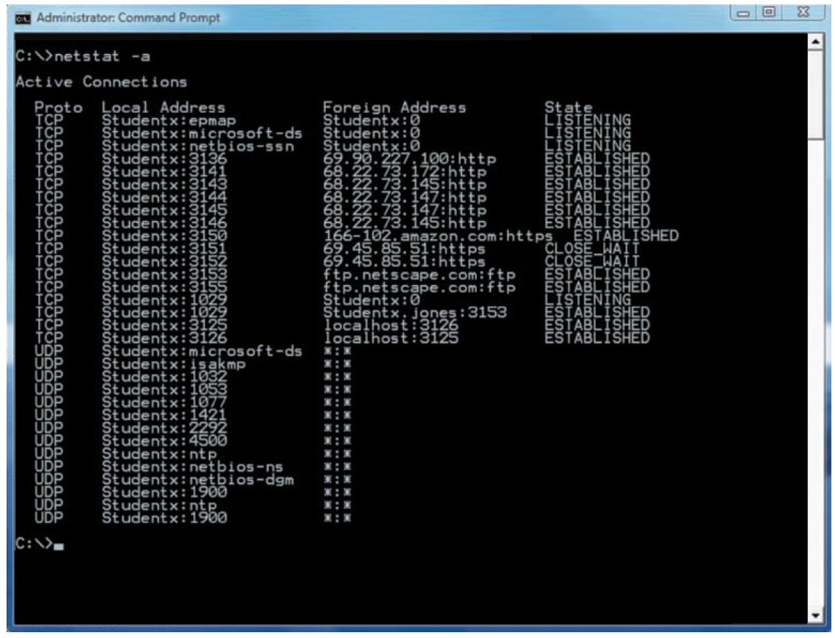
Figure 9-14 Output of a netstat –a command
Courtesy Course Technology/Cengage Learning

Slide 51
Nbtstat
NetBIOS
Protocol runs in Session and Transport layers
Associates NetBIOS names with workstations
Not routable
Can be made routable by encapsulation
Nbtstat utility
Provides information about NetBIOS statistics
Resolves NetBIOS names to IP addresses
Useful only on Windows-based operating systems and NetBIOS
Limited use as TCP/IP diagnostic utility

Slide 52
Hostname, Host, and Nslookup
Hostname utility
Provides client’s host name
Administrator may change
Host utility
Learn IP address from host name
No switches: returns host IP address or host name
Nslookup
Query DNS database from any network computer
Find the device host name by specifying its IP address
Verify host configured correctly; troubleshoot DNS resolution problems

Slide 53
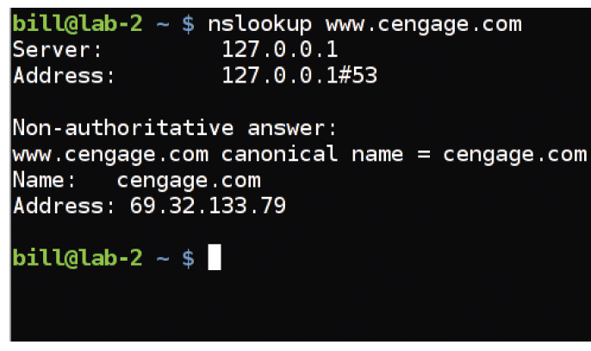
Figure 9-15 Output of a simple nslookup command
Courtesy Course Technology/Cengage Learning

Slide 54
Dig
Domain information groper
Similar to nslookup
Query DNS database
Find specific IP address host name
Useful for diagnosing DNS problems
Dig utility provides more detailed information than nslookup
Flexible: two dozen switches
Included with UNIX, Linux operating systems
Windows system: must obtain third party code

Slide 55
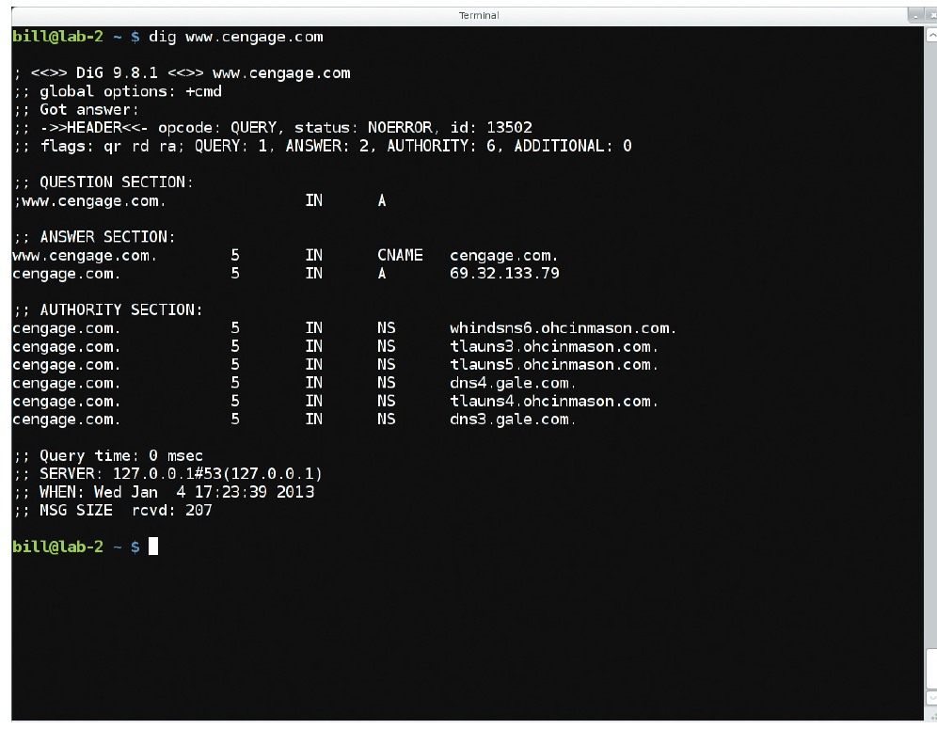
Figure 9-16 Output of a simple dig command
Courtesy Course Technology/Cengage Learning

Slide 56
Traceroute (Tracert)
Windows-based systems: tracert
Linux systems: tracepath
ICMP ECHO requests
Trace path from one networked node to another
Identifying all intermediate hops between two nodes
Transmits UDP datagrams to specified destination
Using either IP address or host name
To identify destination
Several switches available

Slide 57
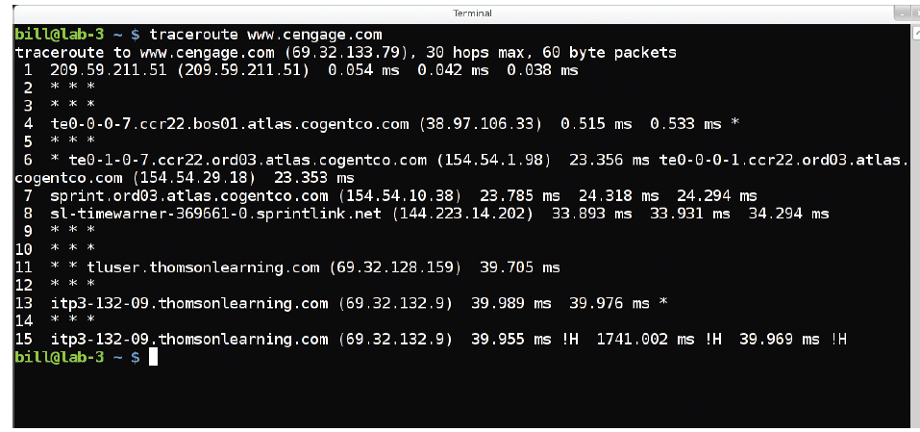
Figure 9-17 Output of a traceroute command
Courtesy Course Technology/Cengage Learning

Slide 58
Mtr (my traceroute)
Comes with UNIX, Linux operating systems
Route discovery, analysis utility
Combines ping, traceroute functions
Output: easy-to-read chart
Simplest form
mtr ip_address or mtr host_name
Run continuously
Stop with Ctrl+C or add limiting option to command
Number of switches refine functioning, output
Results misleading
If devices prevented from responding to ICMP traffic

Slide 59
Mtr (my traceroute)
Windows operating systems
Pathping program as command-line utility
Similar switches to mtr
Pathping output differs slightly
Displays path first
Then issues hundreds of ICMP ECHO requests before revealing reply, packet loss statistics

Slide 60
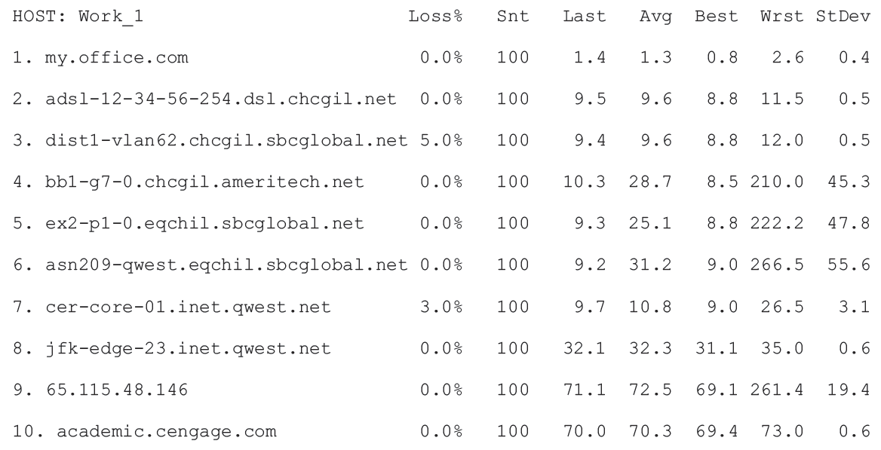
Figure 9-18 Output of the mtr command
Courtesy Course Technology/Cengage Learning

Slide 61
Route
Route utility
Shows host’s routing table
UNIX or Linux system
Type route and press Enter
Windows-based system
Type route print and press Enter
Cisco-brand router
Type show ip route and press Enter

Slide 62
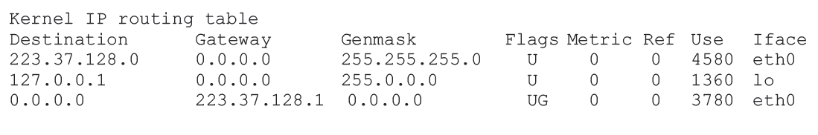
Figure 9-19 Sample routing table
Courtesy Course Technology/Cengage Learning

Slide 63
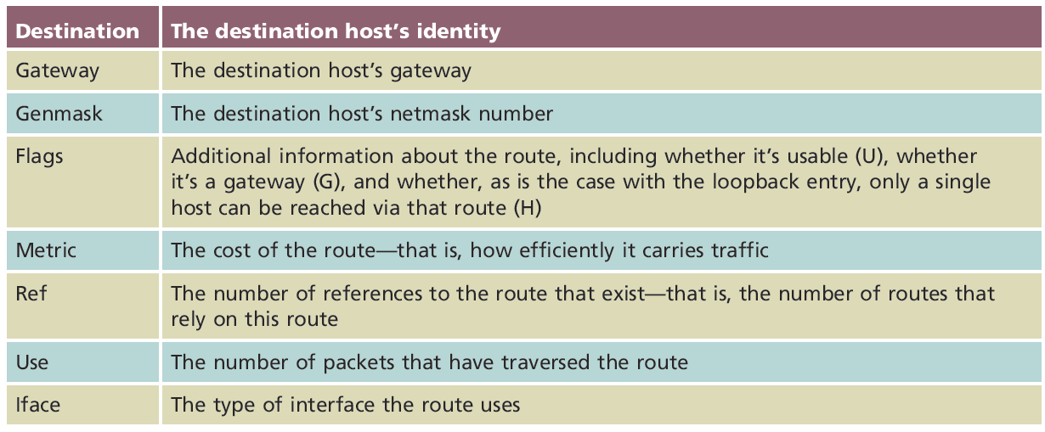
Table 9-7 Fields in routing table on a UNIX host
Courtesy Course Technology/Cengage Learning

Slide 64
Route (cont’d.)
Route command
Add, delete, modify routes
Route command help
UNIX or Linux system
Type man route
Windows system
Type route ?

Slide 65
Summary
Subnetting separates network into multiple segments or subnets
Creating subnets involves changing IP address bits to represent network information
CIDR is a newer variation on traditional subnetting
Last four blocks represent interface in IPv6
Gateways facilitate communication between subnets
Different types of address translation protocols exist
Several utilities exist for TCP/IP network discovery, troubleshooting

